Slide 1

University of Padova Department of Developmental Psychology and Socialization
Visual Working Memory Precision for Emotional Faces in Moebius Patients
Filippo Gambarota Massimiliano Pastore, Roy Luria, Pier Francesco Ferrari and Paola Sessa
Cognitive Science Arena February 7th 2020

Slide 2
Facial Expression Processing

Slide 3
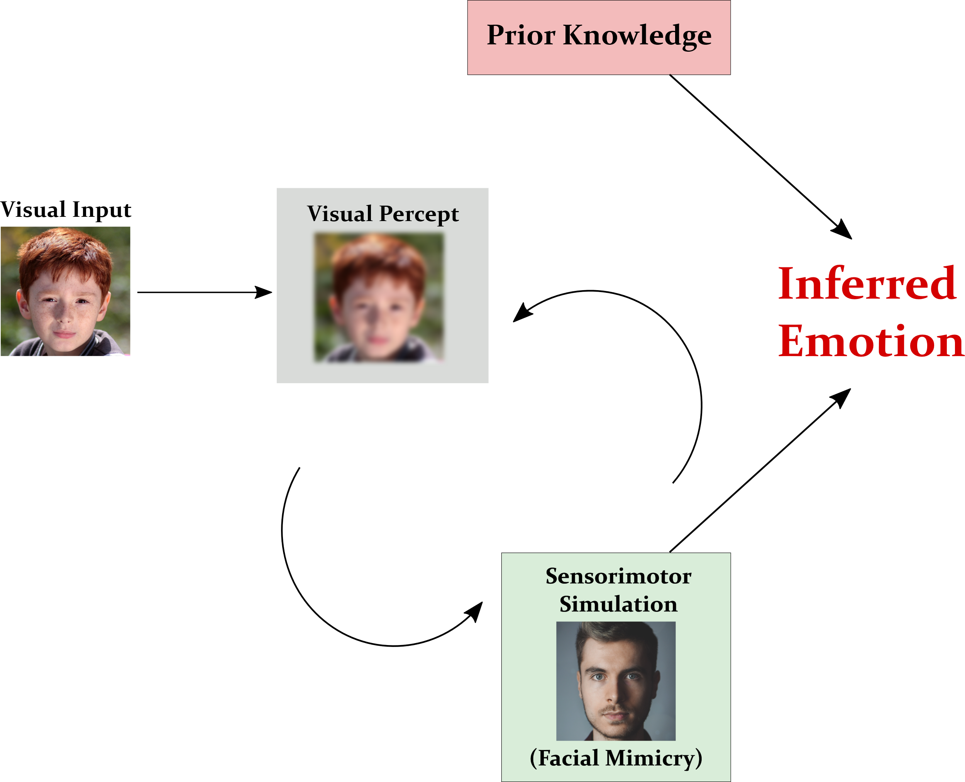
Sensorimotor Simulation
Adapted by Wood et al. 2016

Slide 4

Facial Mimicry
Blocking Facial Mimicry seems to reduce the facial expression recognition accuracy
(Wood et al. 2016)

Slide 5
Moebius Syndrome

Slide 6
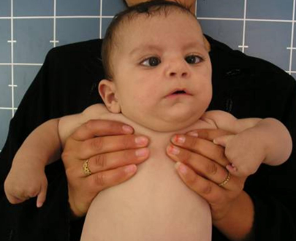
Congenital Facial Mimicry Impairment
Extremely rare diseases that affects cranial nerves causing facial palsy (i.e. a strong and complete facial mimicry blocking)
The verbal component of emotional faces processing has been mainly investigated (De Stefani et al. 2019)

Slide 7
Visual Working Memory

Slide 8
Visual Working Memory Precision
VWM is a limited-space cognitive system in which visual information is temporarily stored and manipulated for further processing
(Luck, 2008; Liesefeld and Müller, 2019)
VWM seems to process faces and facial expressions in a particular way
Electrophysiological correlate of VWM seems to be modulated by facial mimicry manipulation
(Sessa et al., 2019)

Slide 9
The present study

Slide 10
The present study
Investigating the VWM representations precision comparing a group of Moebius patients with healthy Controls.
We use a relatively verbal-free index of face visual processing for better understanding the impact of Facial Mimicry in face processing.

Slide 11




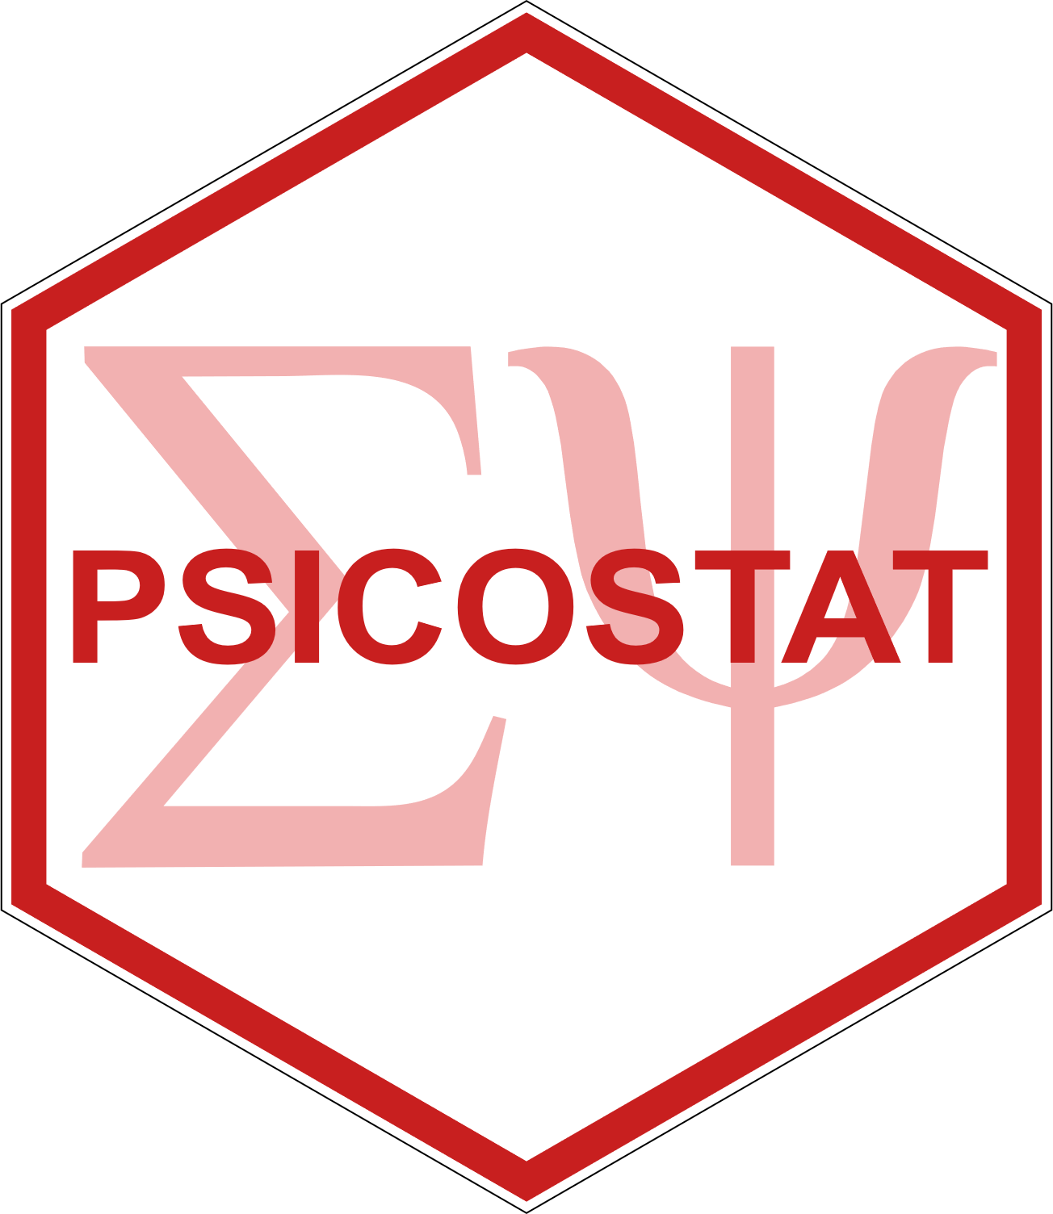

See my Github repository for all data and scripts filippogambarota/vwm_moebius_csa
filippo.gambarota@phd.unipd.it
filippogambarota.netlify.com
@fgambarota
filippogambarota

